Slide 1
Inside Airbnb NYC
Airbnb market structure in New York City
Interactive dashboard and data story
Austin Mo | Nathan Nguyen | Smera Shanmugan
DS2003 | April 21, 2026
Notes:
One way to understand the Airbnb market is to study dense cities where demand, limited space, and pricing pressure all interact. New York City is a strong case for that kind of analysis.
At first, Airbnb in NYC can look like one large citywide marketplace. But as we move through the data, a more uneven structure appears. Activity is not spread evenly. It is concentrated in a smaller set of neighborhoods, and that concentration raises a deeper question: who participates most heavily in this market, and how does that connect to pricing and demand?
Our central claim is that Airbnb in NYC is better understood as a set of submarkets shaped by geography, room type, and host behavior, rather than one uniform market. We use listings and reviews together to trace this structure step by step. The story you will hear today moves from concentration, to pricing, to host composition, to review activity, and then to a final synthesis about how these forces interact.

Slide 2
Project Framing
We aim to analyze how Airbnb supply is distributed across New York City rather than treating the city as one uniform market.
Dataset: Inside Airbnb NYC snapshot (Dec. 4, 2025)
Listings.csv - neighborhood, borough, room type, price, host ID, host listing count, latitude, longitude
Reviews.csv - listing_id, date
Research Questions
How is Airbnb listing activity concentrated across NYC boroughs and neighborhoods?
How do listing prices vary across boroughs, neighborhoods, and room types?
How do prices differ between single-listing and multi-listing hosts?
How is 2025 review activity associated with listing prices?
Notes:
We framed the project around a simple but important market question: is Airbnb in NYC one market, or many local submarkets operating under one platform? To answer that, we used the Inside Airbnb NYC snapshot from December 4, 2025.
From listings data, we used borough, neighborhood, room type, price, host-related fields, and location coordinates. From reviews data, we linked listing ID and date to construct 2025 review activity. That lets us compare supply structure and engagement patterns together.
Our analysis is organized around four linked questions. First, where is listing activity concentrated? Second, how do prices vary across neighborhoods and room types? Third, how do multi-listing hosts compare with single-listing hosts? Fourth, how is 2025 review activity associated with listing price?
This sequence matters because each question builds on the previous one. If concentration exists, pricing differences become easier to interpret. If host structure differs across areas, that helps explain those pricing patterns. Review activity then adds demand context to the same structure.

Slide 3
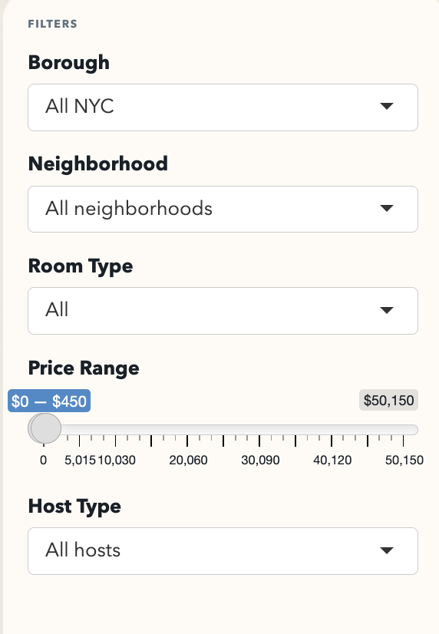
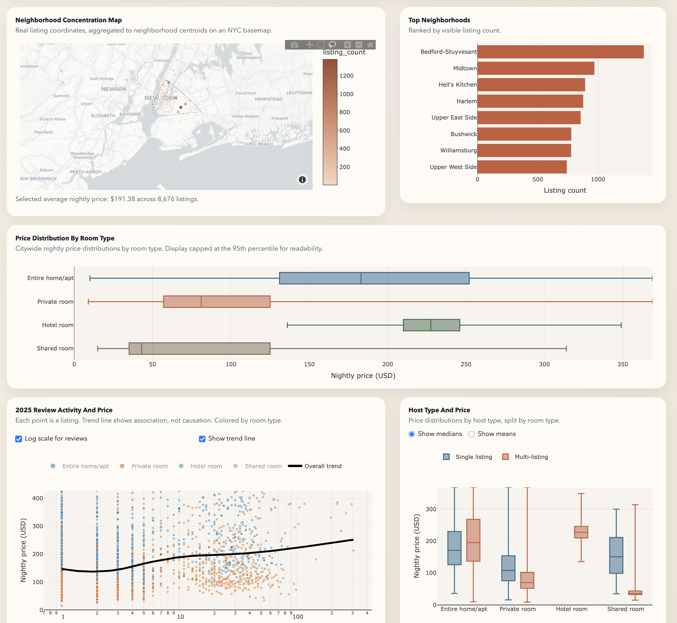
Dashboard Structure
Notes:
This slide shows the structure of the dashboard we used to support both storytelling and exploration. The controls allow filtering by borough, neighborhood, room type, host type, and price range. Those filters update the visuals together so we can test whether patterns persist under different views.
At the top, KPI cards summarize the current filtered state. Below that, the map and neighborhood ranking show where supply is concentrated. Price distributions show market segmentation by room type. Host-type views compare single-listing and multi-listing behavior. The review-price view adds engagement context for 2025.
The design is intentional: we present a narrative first, but the same interface can challenge or validate that narrative in real time. If the story only worked for one static cut of data, it would be weak. The dashboard lets us check robustness by shifting filters and seeing whether the same structural pattern remains: uneven concentration, segmented pricing, and differentiated host behavior.

Slide 4
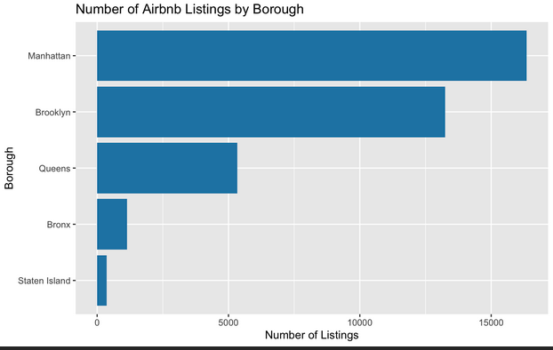
Finding 1: Listing Concentration
Notes:
The first major finding is concentration. Once listings are mapped and ranked, a clear imbalance appears. Manhattan and Brooklyn account for most listings in the cleaned dataset, while the remaining activity is distributed across Queens, the Bronx, and Staten Island.
That means Airbnb presence is not evenly citywide. Instead, supply clusters in a limited set of neighborhoods. Places such as Bedford-Stuyvesant, Midtown, and Hell's Kitchen stand out with especially high listing counts.
This is more than a descriptive point. Concentration shapes market mechanics. Areas with dense supply are where competition, visibility, and pricing pressure are most intense. Areas with thinner supply behave differently. So rather than thinking of NYC Airbnb as one average marketplace, this first result suggests a smaller set of high-activity zones drives a large share of visible supply.
That concentration finding is the foundation for all later results. The price and host patterns we discuss next make the most sense when read within this uneven geographic structure.

Slide 5
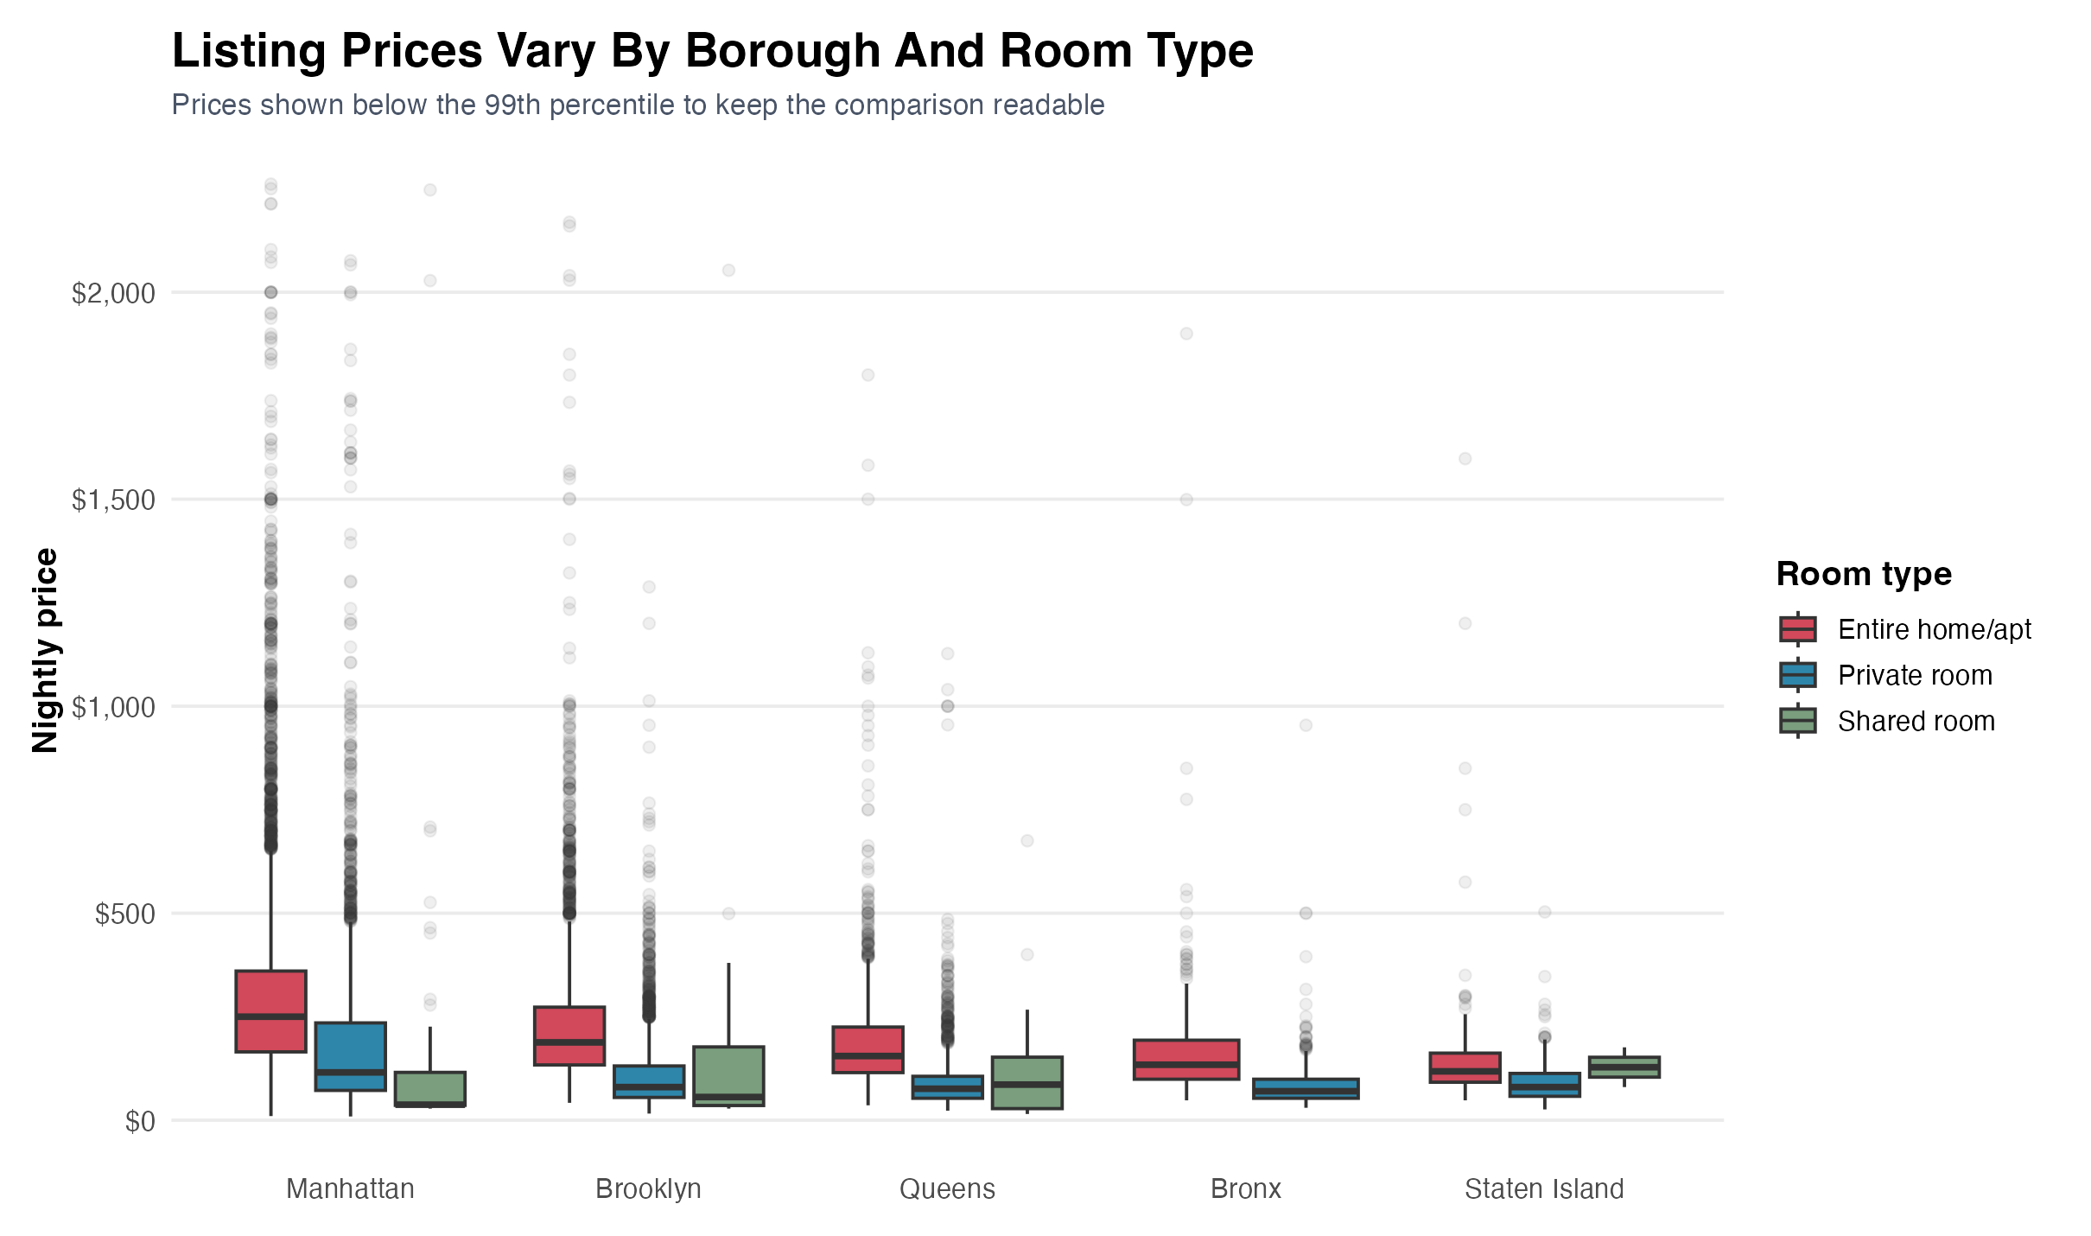
Finding 2: Price Variation
Notes:
The second finding is price segmentation, and the differences are substantial. Across the city, two drivers explain much of the variation: where the listing is located and what type of space is offered.
Entire homes are consistently priced above private or shared rooms, especially in Manhattan and parts of Brooklyn. Outer borough listings generally show lower prices and often tighter ranges. But even within the same borough, the spread can still be wide, which indicates multiple price tiers coexisting in local markets.
The implication is that price is not just an individual listing attribute. It is tied to local market context and product type. A single citywide average price hides this structure and can misrepresent what hosts and guests actually face in different areas.
This finding extends the concentration story. High-activity areas are not just denser in listings; they also participate in different pricing regimes. That reinforces the view that NYC Airbnb is segmented into local submarkets rather than functioning as one uniform pricing environment.

Slide 6
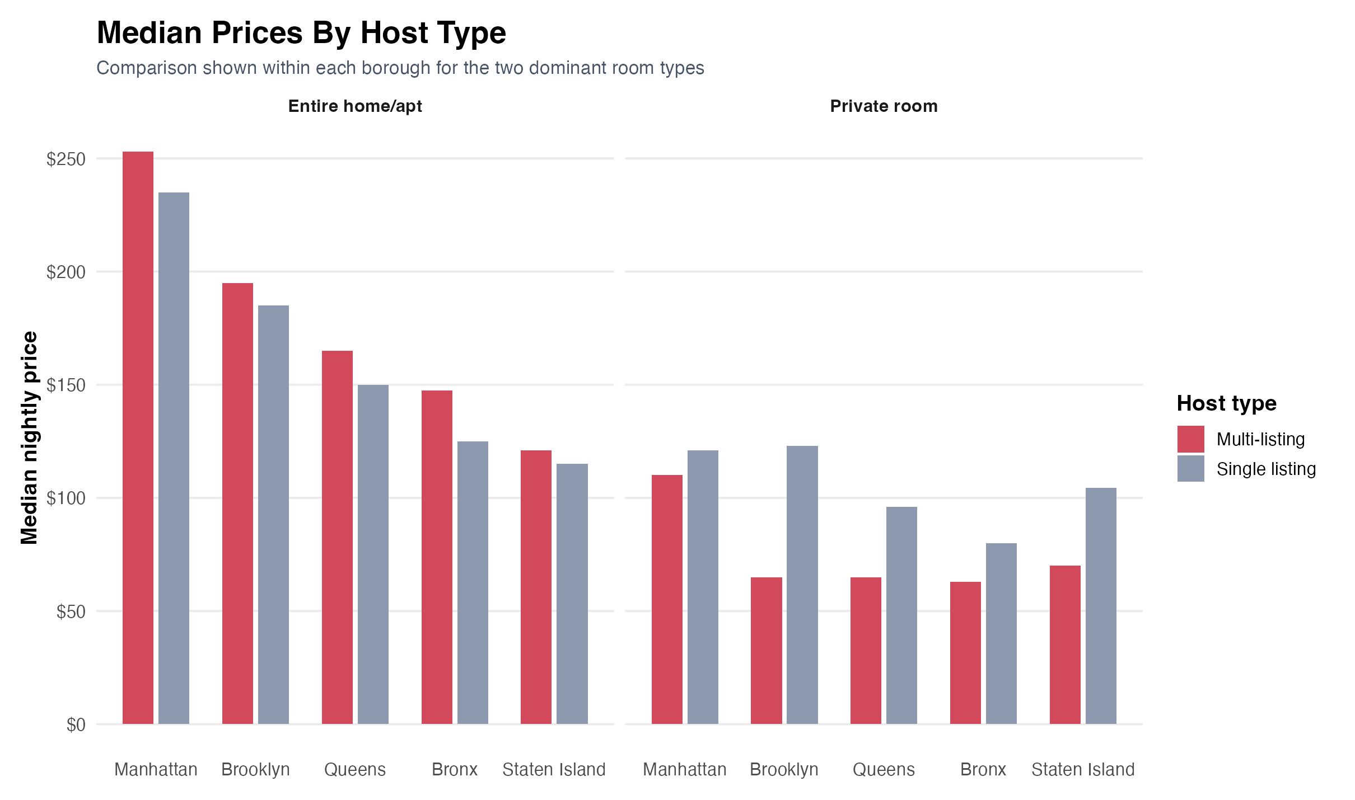
Finding 3: Host Structure
Notes:
The third finding introduces host behavior as another structural layer. Not all hosts participate in the same way. Comparing single-listing hosts with multi-listing hosts reveals a more commercial pattern in parts of the market.
Multi-listing hosts are more common in high-activity zones, and in several borough-room type comparisons they post higher median prices. That does not prove causality, but it does suggest that some segments operate less like occasional home sharing and more like scaled short-term rental business activity.
This matters because host composition helps explain why market outcomes vary across place and product type. If one area has more multi-listing operators and another has mostly single-listing hosts, their pricing and supply behavior may diverge even when both are inside the same platform.
So at this point in the story, the market looks layered: geographic concentration sets the stage, room type shapes price levels, and host structure adds a commercialization dimension that reinforces unevenness.

Slide 7
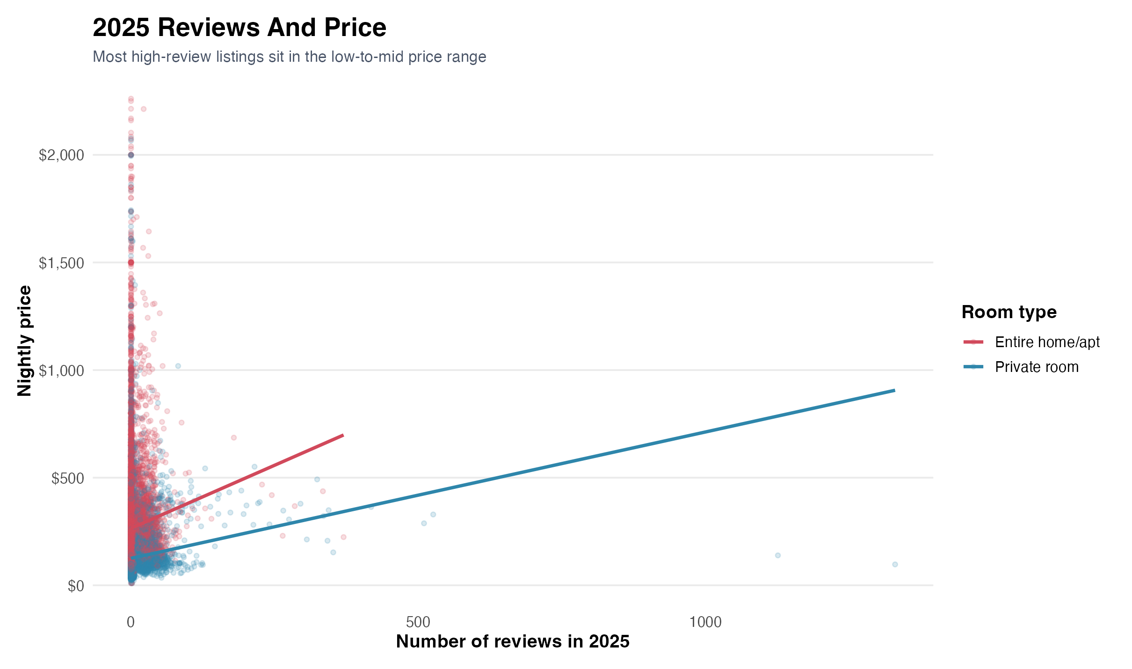
Finding 4: Review Activity And Price
Notes:
The fourth finding adds review activity as a demand-facing signal. We treat reviews as a proxy for visible engagement, not a direct measure of bookings, and we interpret all patterns as associative rather than causal.
In 2025 data, listings with the highest review counts tend to cluster in lower-to-middle price ranges instead of the very top of the market. This suggests that the most actively reviewed inventory is often relatively affordable, while the highest-priced listings do not necessarily produce the highest review volume.
That pattern points to a split between volume-oriented segments and premium segments. One part of the market appears to generate more visible activity at moderate price points, while another part serves a smaller high-price segment with lower visible review intensity.
This final analytical layer complements earlier findings by linking engagement to the same segmented structure we saw in concentration, price, and host behavior.

Slide 8
Conclusion
Main takeaway: NYC Airbnb behaves as a set of uneven, spatially concentrated submarkets rather than one uniform market.
Evidence summary:
- Listings are concentrated in a smaller set of neighborhoods and boroughs
- Prices are segmented by room type and geography
- Host structure and 2025 review activity add context to how market activity is distributed
Limitations:
- Reviews are a proxy for activity, not direct bookings
- Listing stock is snapshot-based
- Findings are associative, not causal
Implication: We should interpret NYC Airbnb through local submarkets rather than citywide averages.
Notes:
Putting everything together, Airbnb in New York City does not operate as one single unified market. It functions as uneven, spatially concentrated submarkets shaped by location, room type, host behavior, and price.
A relatively small set of neighborhoods accounts for a large share of visible supply. Pricing reflects both geography and listing type, with clear segmentation rather than one citywide pattern. Host composition adds evidence of a more commercialized segment, especially where supply is already dense. Review activity in 2025 suggests that lower-to-middle priced listings often drive more visible engagement than the most expensive listings.
Our main limitations remain important: review counts are proxies, listing stock is snapshot-based, and findings are associative, not causal. Even with those limits, the evidence consistently supports the same interpretation.
The key takeaway is that NYC Airbnb mirrors the city itself: uneven, segmented, and strongly shaped by place. For analysis and decision-making, local submarket context is more informative than citywide averages.

